Slide 1



FIFA World Cup Analyasis
Predicting Football Player Performance:
Guide:
Mr. Sayed Talha Hamid Project By :
1. Amarnath Shende
2. Raghini Mahajan
3. Aarti Patil

Slide 2

Overview
This presentation delves into the realm of sports analytics, focusing on football's biggest stage-the FIFA World Cup.
We'll examine:
The significance of predicting player performance
Team and player statistics
Insights on popular World Cups and home ground advantage

Slide 3

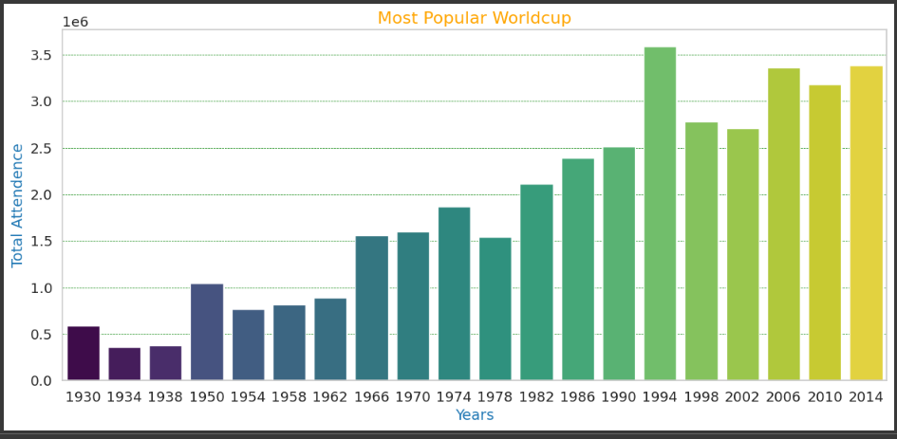
Popular Worldcup

Slide 4
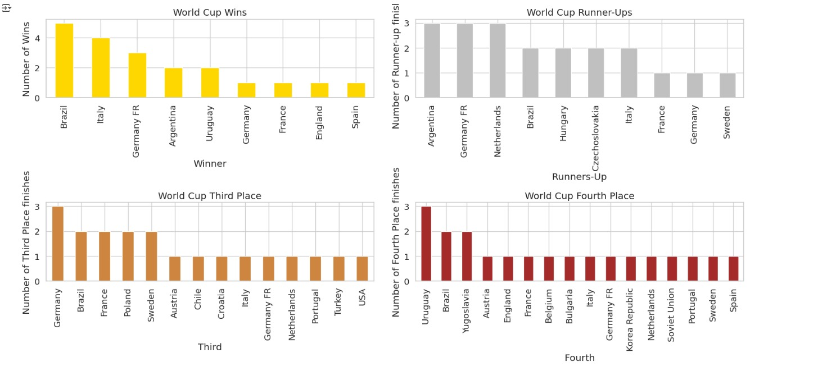
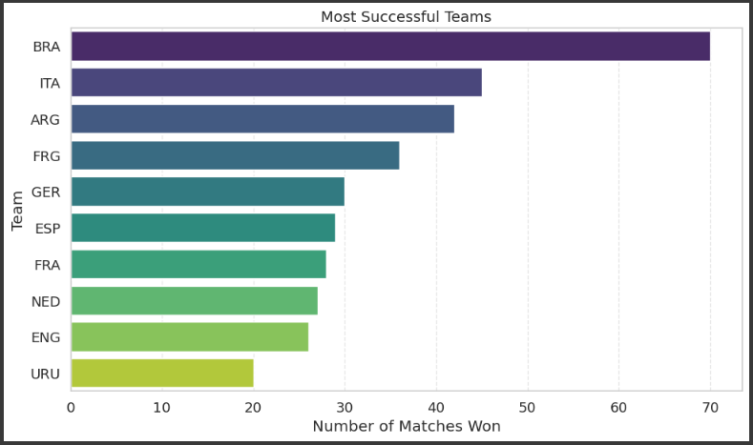
Successful Teams
Successful Teams

Slide 5
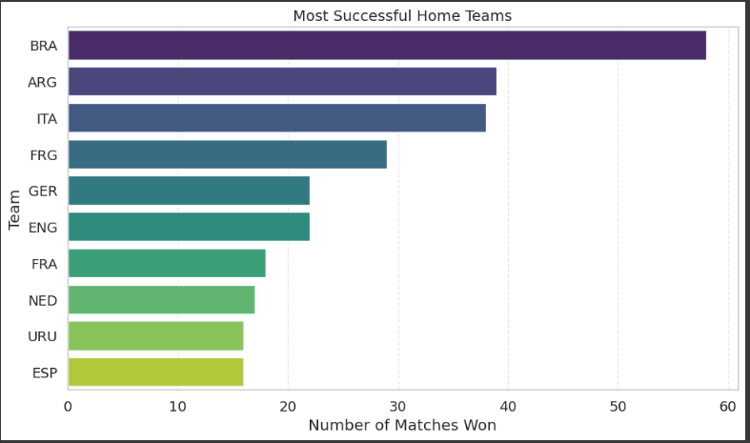
Successful Home Teams

Slide 6
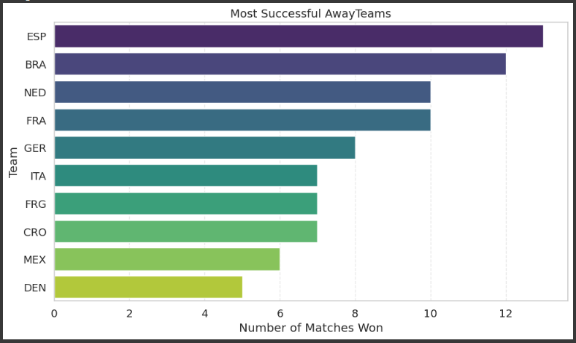
Successful Away Teams

Slide 7
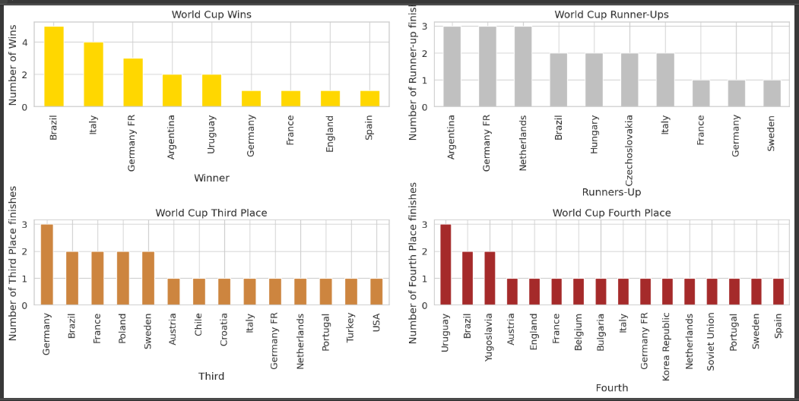

Slide 8
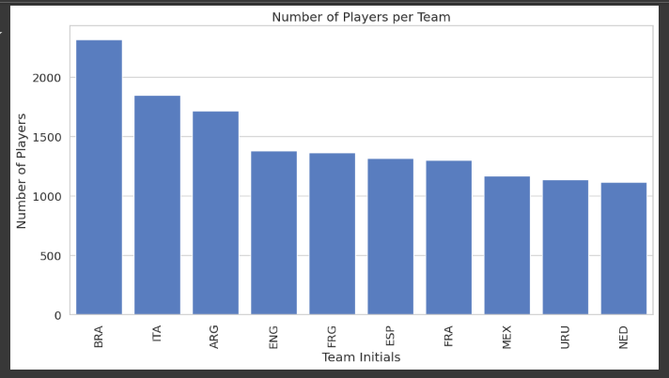
Player Count as per Team

Slide 9
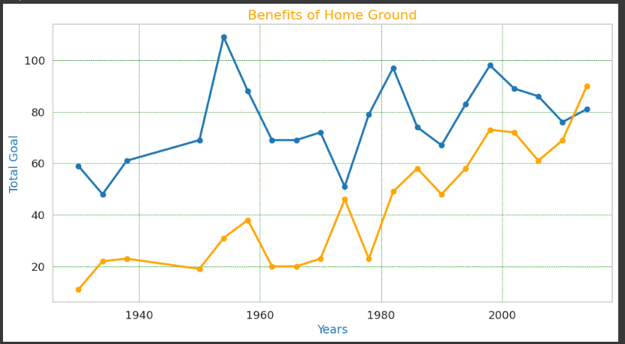
Benefits of Home Ground

Slide 10
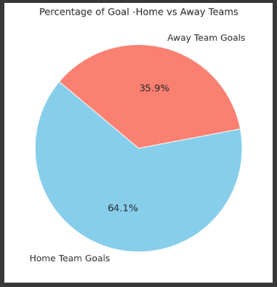
Home- Away Team Goals

Slide 11

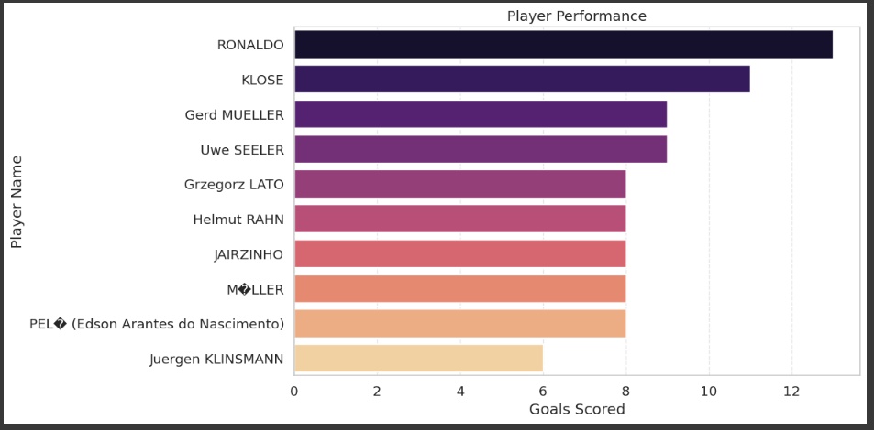
Player Perpormance

Slide 12
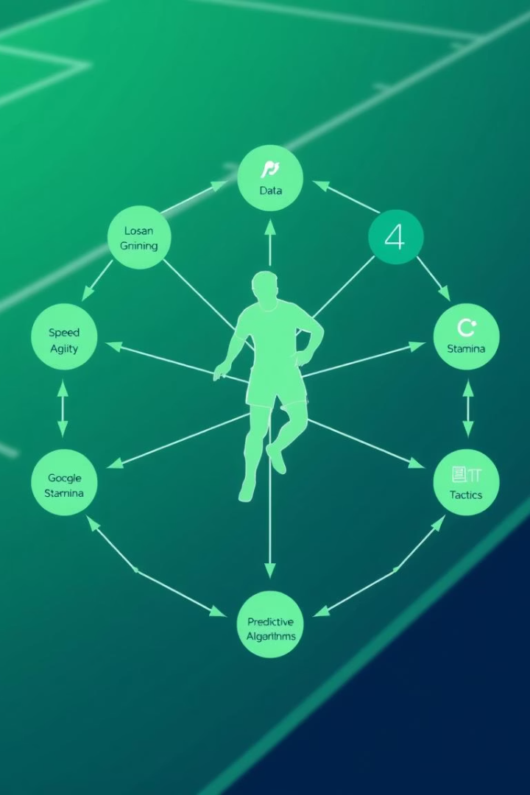
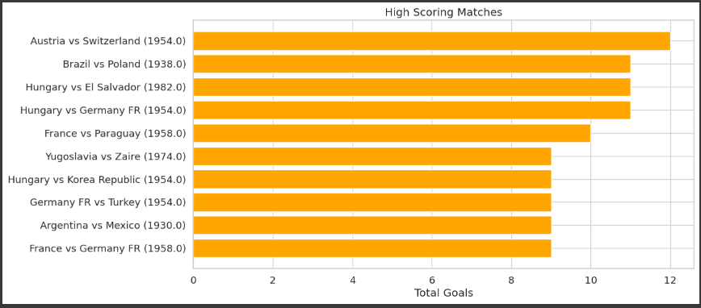
High Scoring Matches Due to Wining Conditions

Slide 13
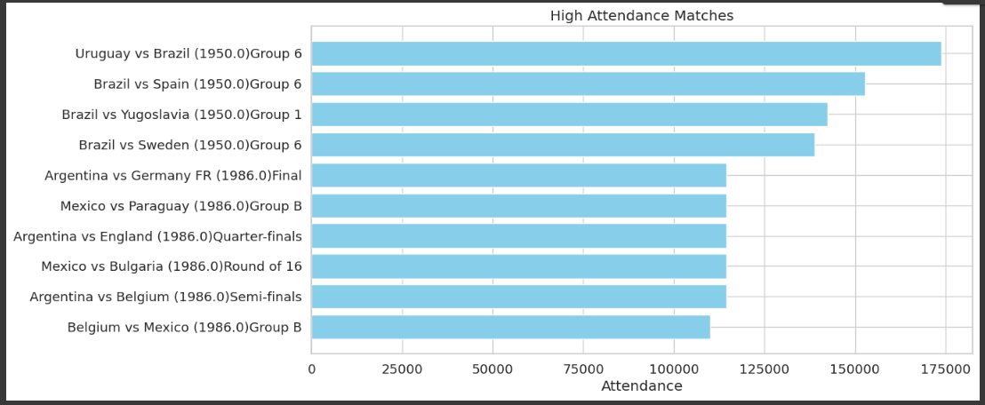
High Attendence Matches

Slide 14
Summary
This study analyzes historical FIFA data to highlight patterns in team dynamics and player performance.
Takeaways include:
Importance of predictive analytics in strategy
Impact of home-ground advantage
Historical benchmarks for team and player success

Slide 15

Thank You

